Slide 1
Tiranga Creatives

Slide 2
Moments With Tiranga

Slide 3
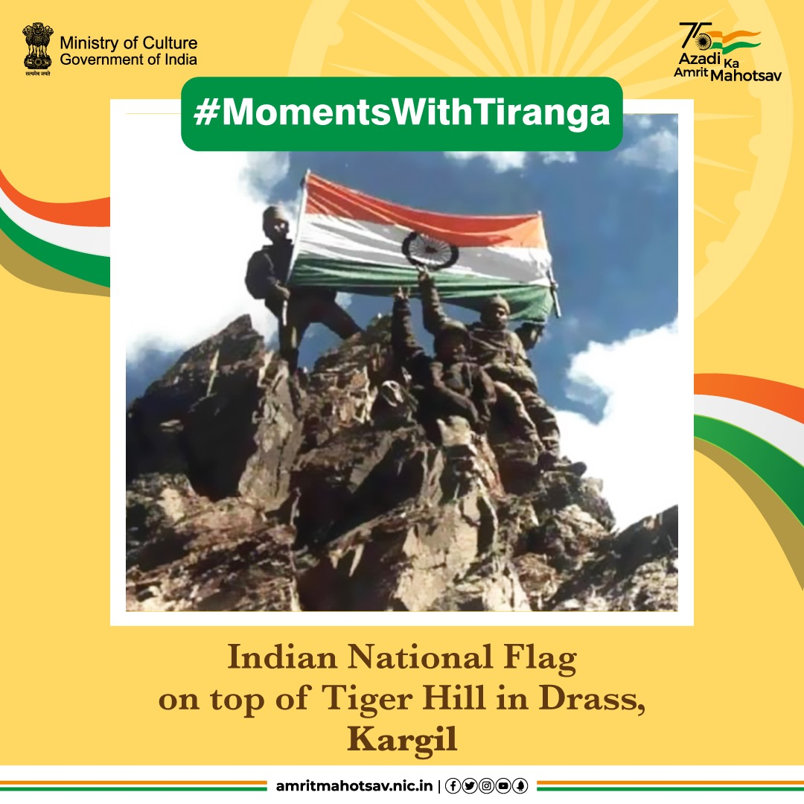
Can there ever be a better picture than this!!? AWESTRUCK 🇮🇳🙏#AmritMahotsav #MomentsWithFlag #HarGharTiranga #MainBharatHoon #IndiaAt75 #ActionsAt75 @adgpi
IC: @Flamboyantpo1

Slide 4
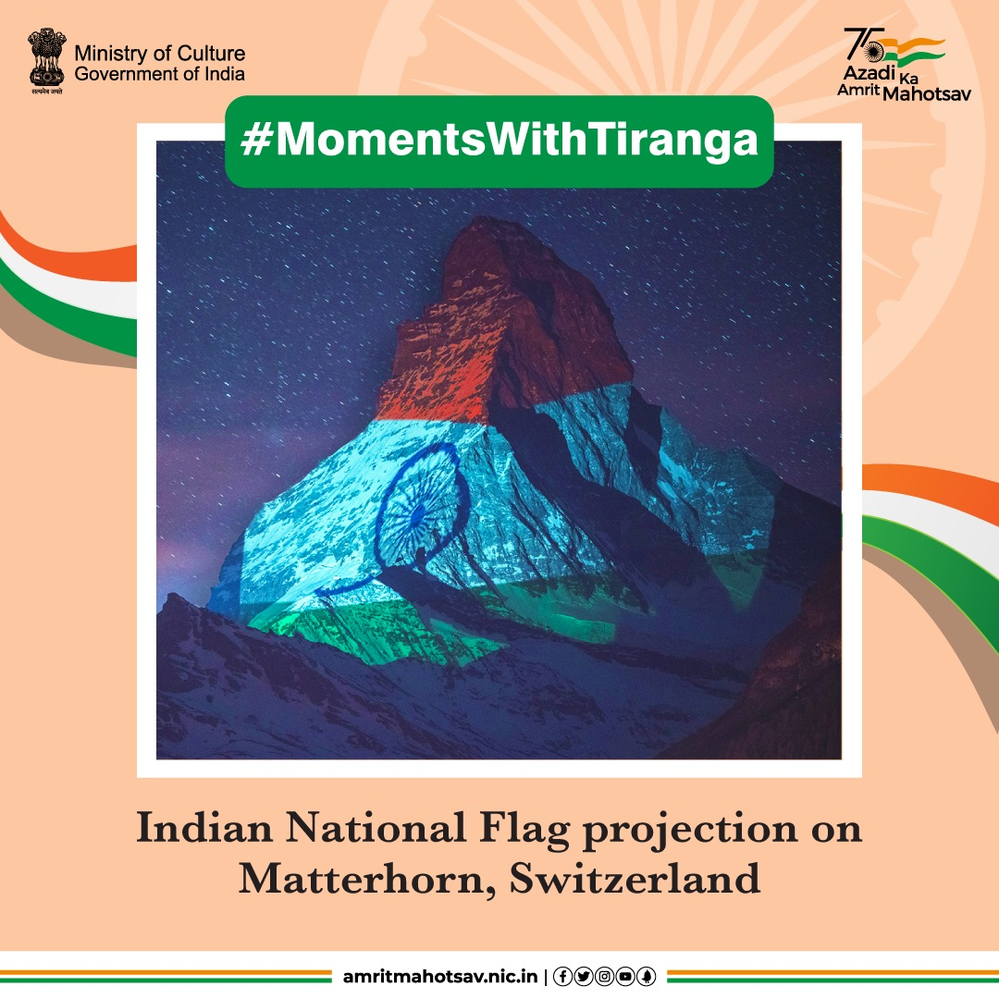
Of hope, love & strength...
The Matterhorn mountain in Swiss Alps lit up in Tricolours in 2020 to send out a message of support & solidarity for India in its fight against COVID-19 🇮🇳#AmritMahotsav #MomentsWithTiranga #HarGharTiranga #MainBharatHoon #IndiaAt75 #ActionsAt75

Slide 5
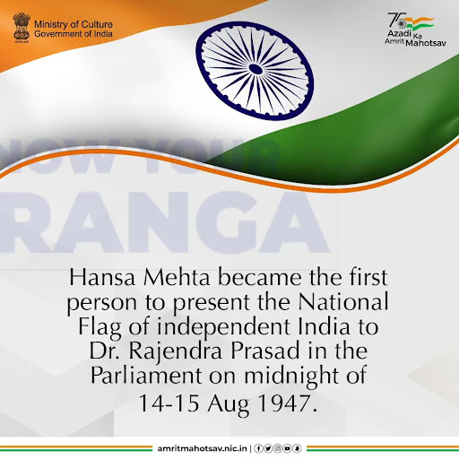
Leading a group of 72 women, Hansa Mehta presented the first National Flag of independent #India to Dr. Rajendra Prasad, the Chairman of the Constituent Assembly, in the Parliament on the midnight of 14-15 Aug 1947 🇮🇳#AmritMahotsav #KnowYourTiranga #HarGharTiranga #MainBharatHoon #IndiaAt75 #ActionsAt75 #Trivia
Download link:
https://drive.google.com/file/d/1cVJDizwB5ZkUoaGPmcP0a-3-QEpLKK6t/view

Slide 6
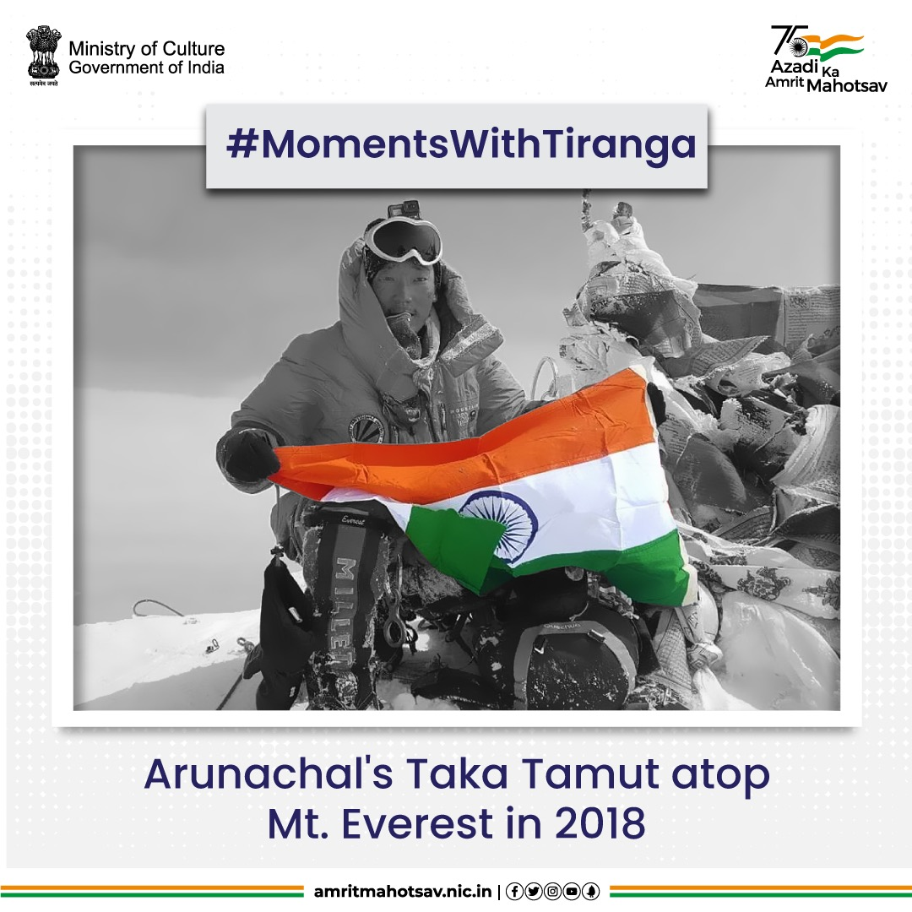
Winner of 2019 Tenzing Norgay National Adventure Award, #TakaTamut scaled the Mt Everest in 2018 without the help of sherpas & proudly unfurled the Tricolour at the top #AmritMahotsav #MomentsWithTiranga #HarGharTiranga #MainBharatHoon #IndiaAt75 #ActionsAt75

Slide 7
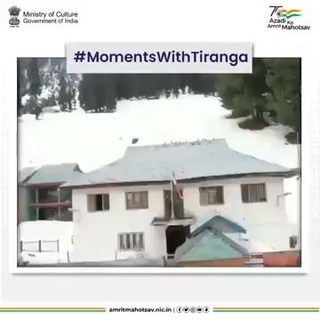
Watching his video of our #Tiranga being unfurled by the police personnel at Sonamarg Police Station in #Kashmir always gives us goosebumps. Salute! 🇮🇳#AmritMahotsav #MomentsWithTiranga #HarGharTiranga #MainBharatHoon #IndiaAt75 #ActionsAt75 VC: @mangalpady
Download link:
https://drive.google.com/file/d/16rSJuGuZ2xngsP7jPdtNyWtNcIeoNflu/view?usp=sharing

Slide 8
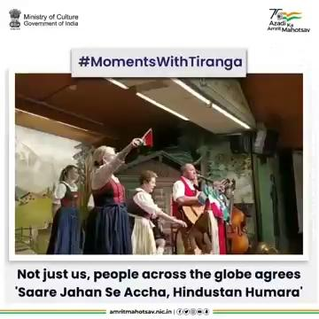
Watch Austrians sing ""Saare Jahan Se Accha Hindustan Humara' at #Tyroleanevening in Austria & unfurl the Indian National Flag 🇮🇳 #AmritMahotsav #MomentsWithTiranga #HarGharTiranga #IndiaAt75 #ResolveAt75 VC: @iFaridoon
Download link:
https://drive.google.com/file/d/1BaGC_V0ZU8SAqgZReTdbjlV-IPAoo61R/view?usp=sharing

Slide 9
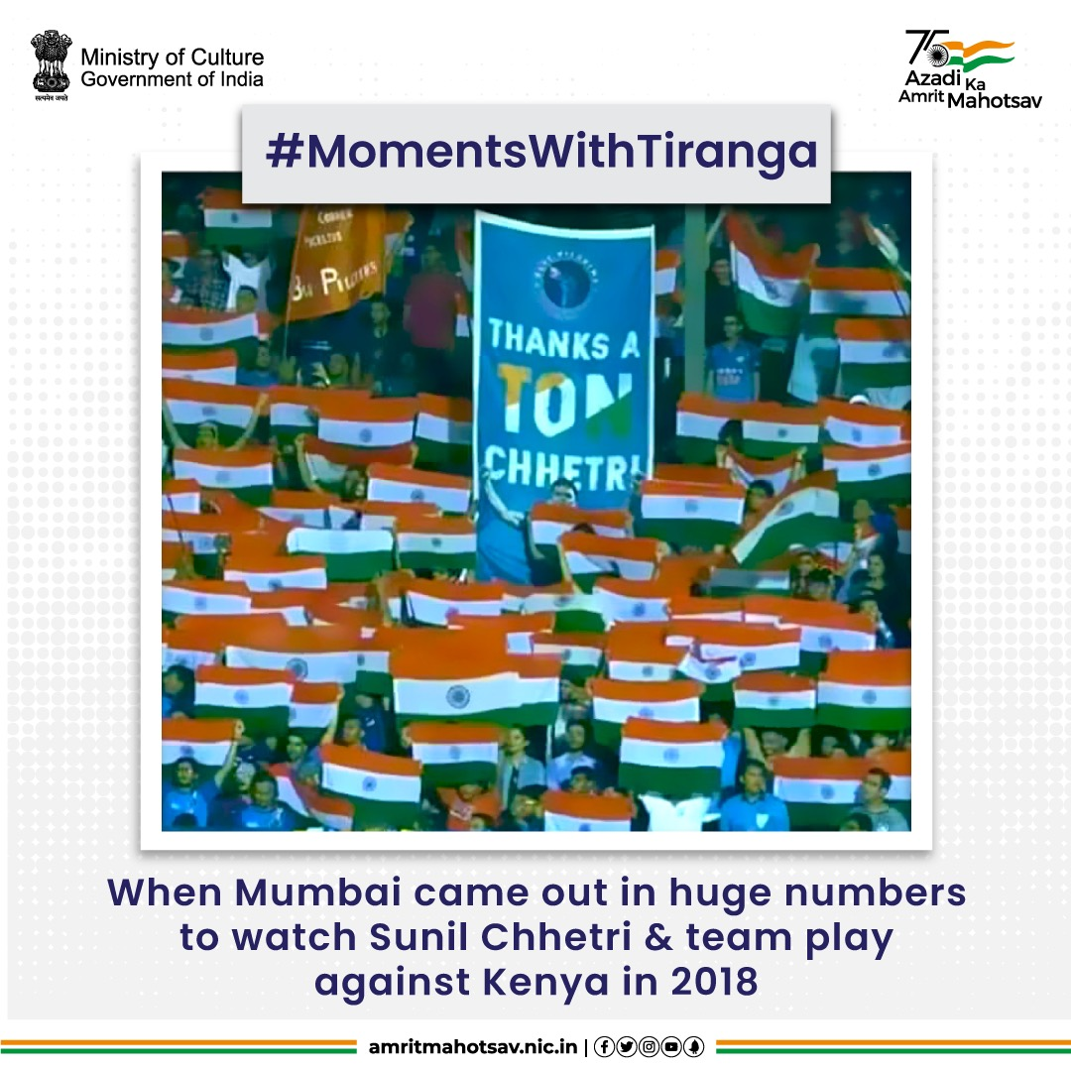
For the love of football!⚽
Mumbai thronged the stadium to watch @chetrisunil11 & boys in action against Kenya in 2018. The chants of 'INDIA...INDIA' filled the arena, making it one of the most memorable matches to watch🇮🇳 #AmritMahotsav #MomentsWithTiranga #HarGharTiranga #IndiaAt75 #ResolveAt75 @YASMinistry

Slide 10
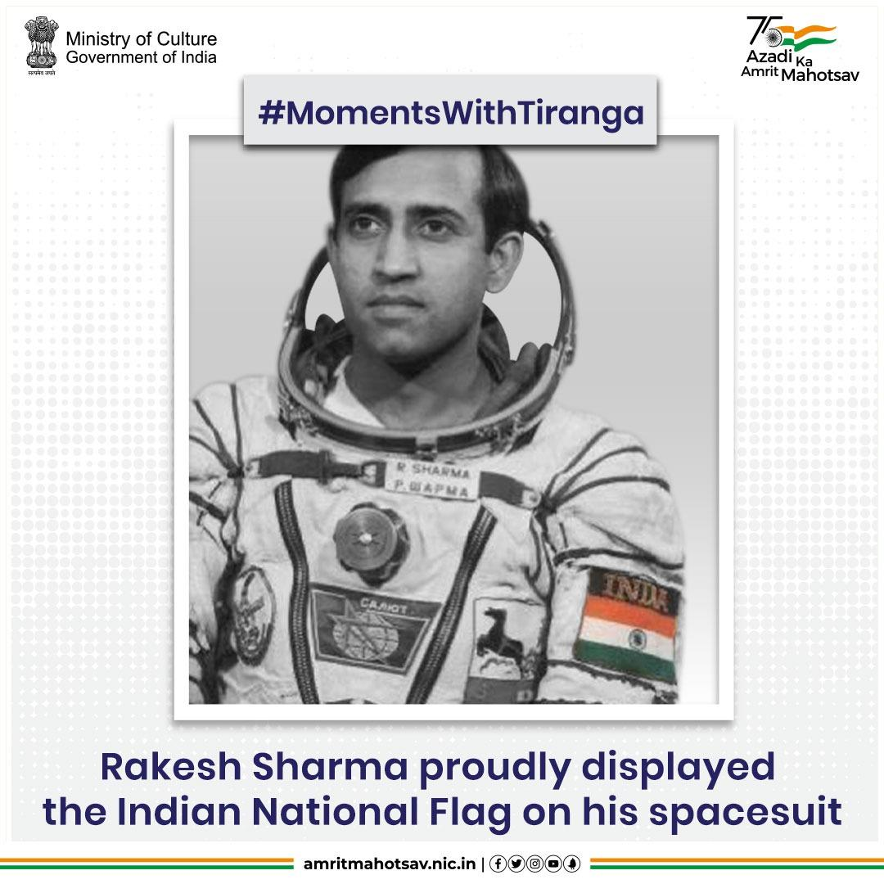
Taking India to the space! 👨‍🚀🚀
In the 1984 space flight, the Indian National Flag flew into space as an emblem on the spacesuit worn by Cosmonaut Wg Cdr #RakeshSharma. PROUD! 🇮🇳 #AmritMahotsav #MomentsWithTiranga #HarGharTiranga #IndiaAt75 #ResolveAt75

Slide 11
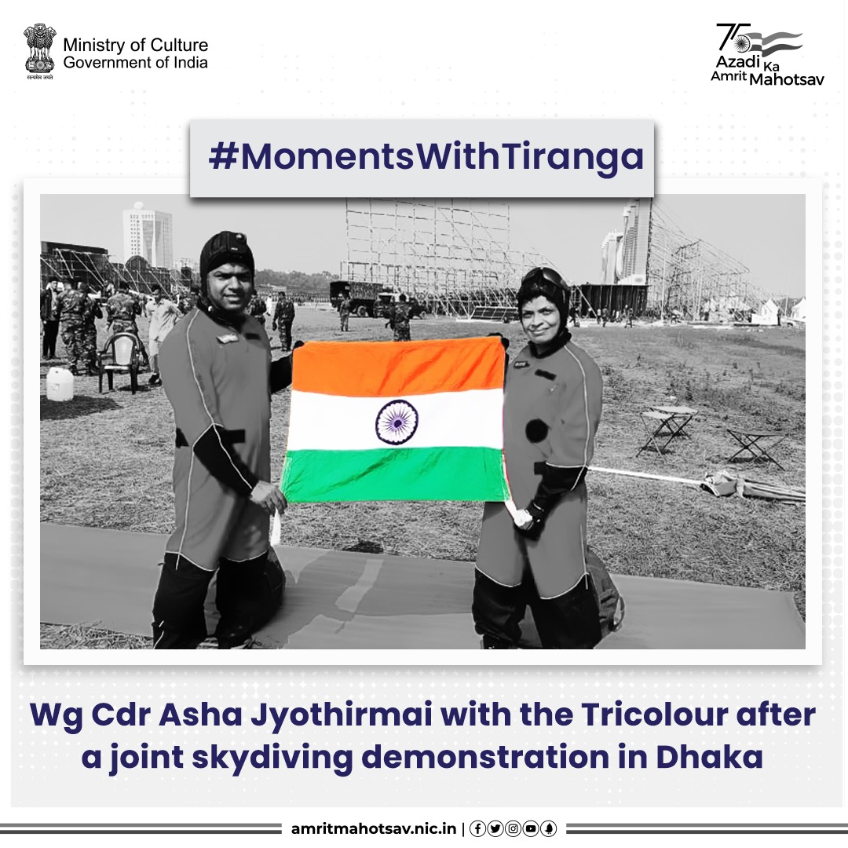
Up above the world so high...🇮🇳
Wg Cdr Asha Jyothirmai of #IAF carried out a joint skydiving demonstration along with skydivers of Bangladesh Air Force at Dhaka to celebrate Victory day of #1971war. #AmritMahotsav #MomentsWithTiranga #HarGharTiranga #MainBharatHoon #IndiaAt75 @IAF_MCC

Slide 12
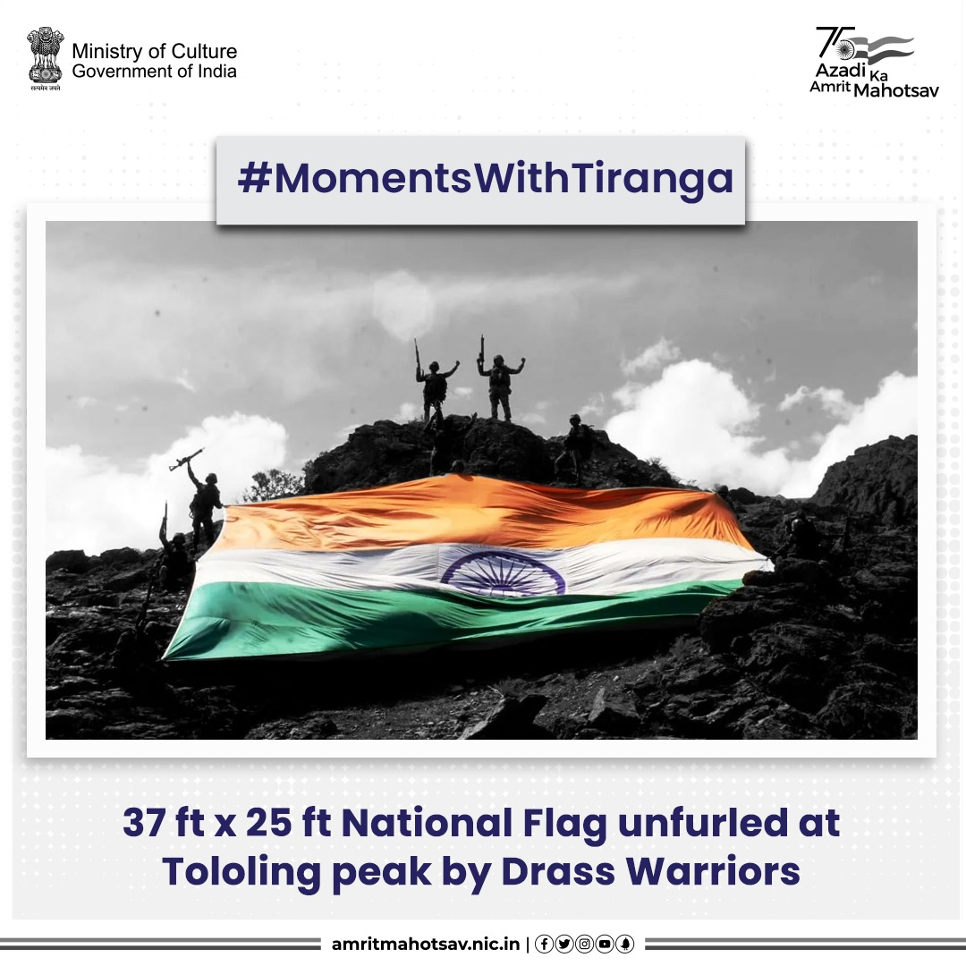
A trekking expedition was organized by Drass Warriors to unfurl a 37 ft by 25 ft National Flag at Tololing peak. The trek was part of a tribute to the bravehearts of the #IndianArmy #AmritMahotsav #MainBharatHoon #IndiaAt75 #ActionsAt75 @adgpi IC: @NorthernComd_IA

Slide 13
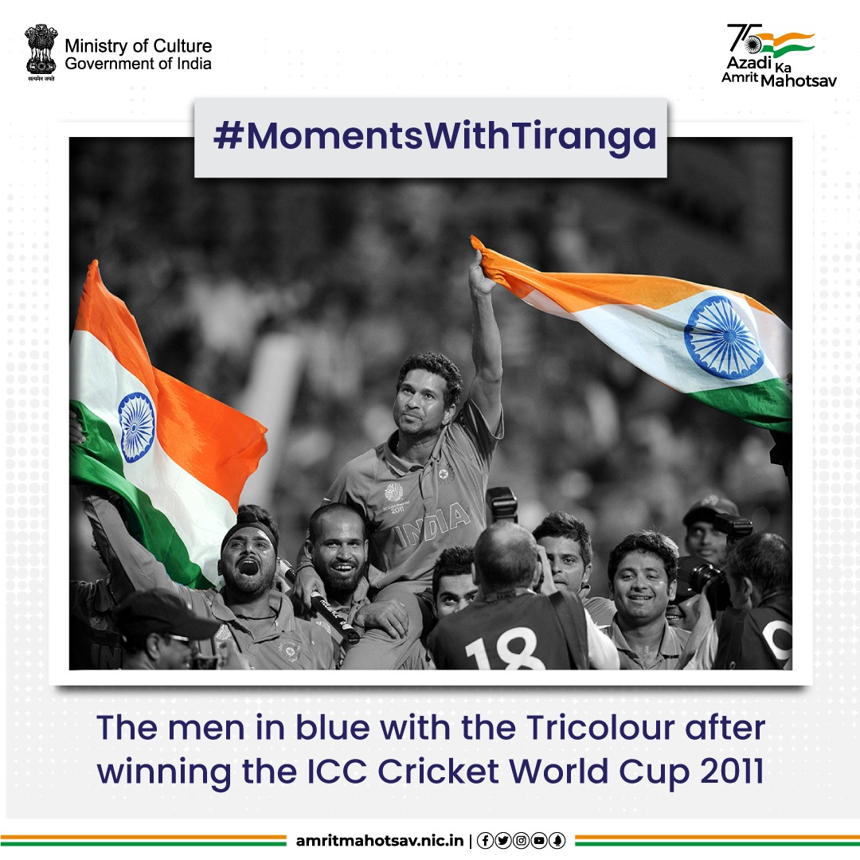
History repeats! The men in blue made the country proud & kept the #Tiranga high with the #ICC World Cup win in 2011. PROUD👏🇮🇳 #AmritMahotsav #MomentsWithTiranga #HarGharTiranga #MainBharatHoon #IndiaAt75 #ResolveAt75 @cricketworldcup @ICC

Slide 14
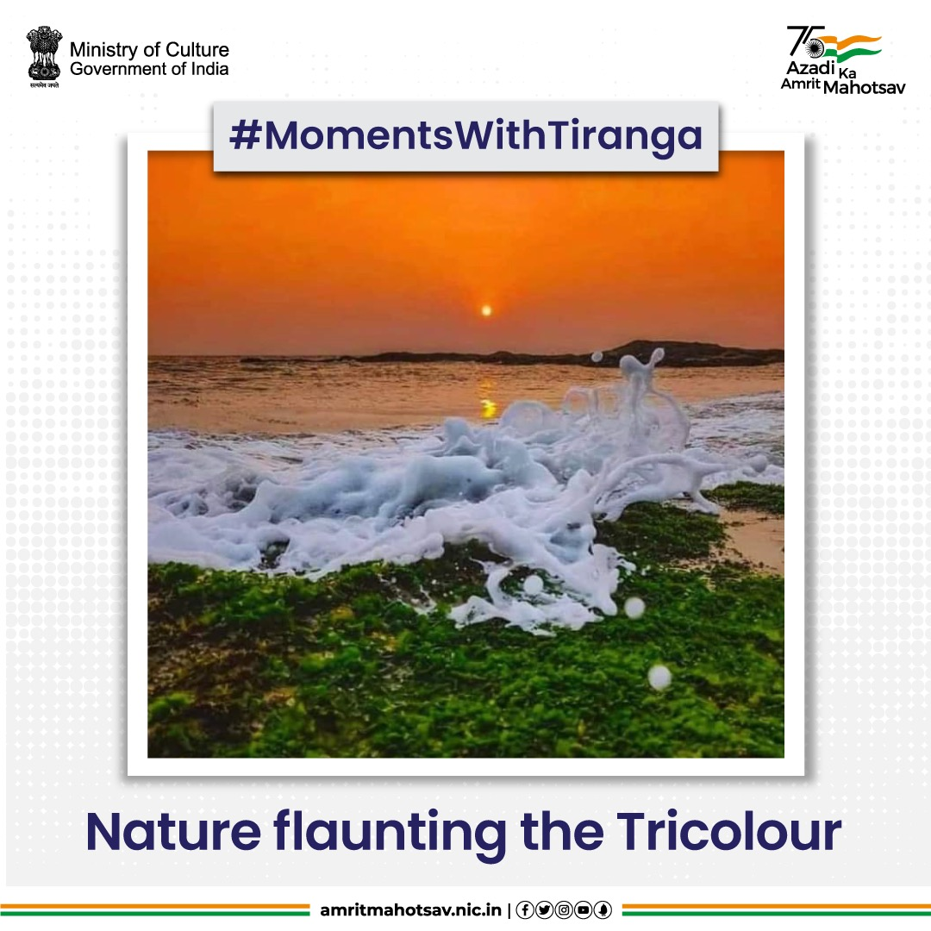
Our pride, the tricolor in nature ❤️🇮🇳 #AmritMahotsav #MomentsWithTiranga #HarGharTiranga #MainBharatHoon #IndiaAt75 IC: @singhsanjeevku2

Slide 15
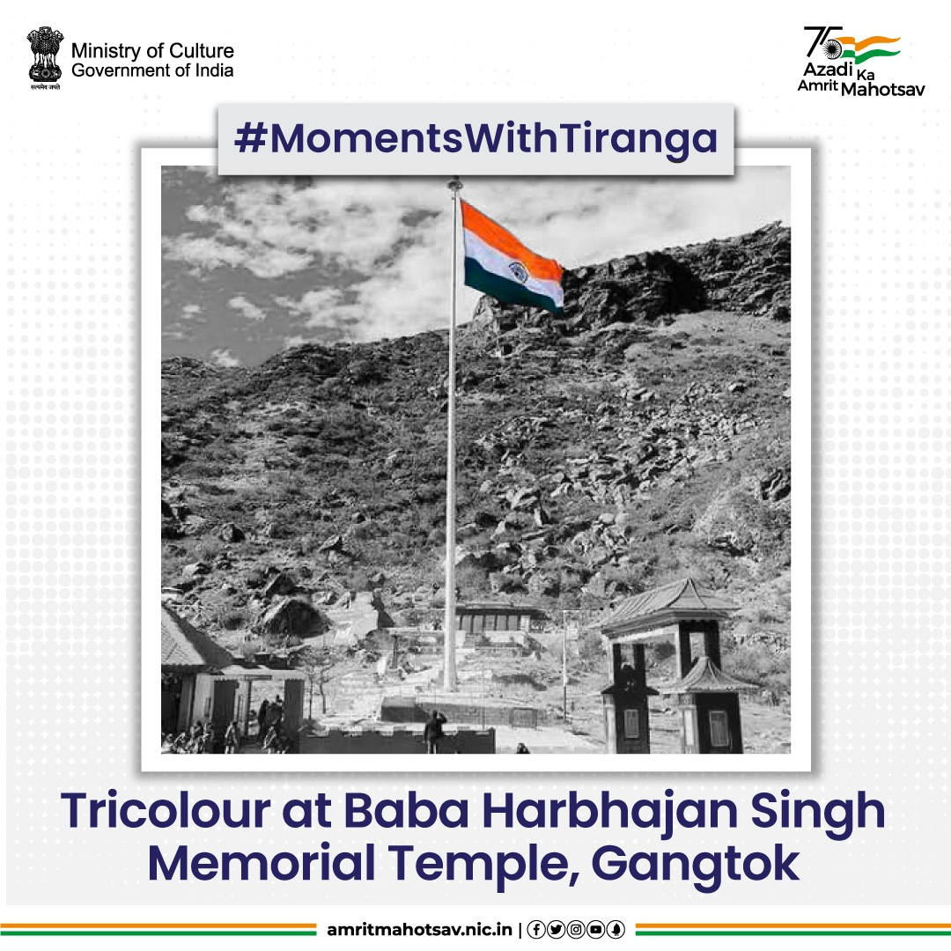
Come rain, snow, or sunshine, may our Tricolor always keep flying high- Wish of every Indian ❤️🇮🇳 #AmritMahotsav #MomentsWithTiranga #HarGharTiranga #MainBharatHoon #IndiaAt75 IC: @Jayalko1

Slide 16
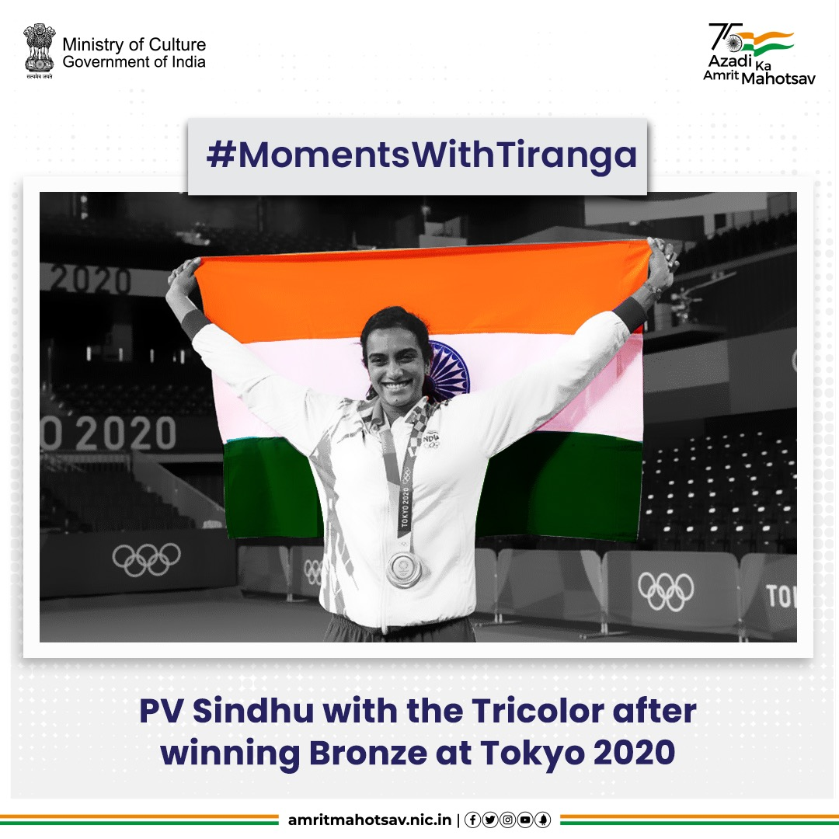
A moment that will remain etched in our memories forever!
@Pvsindhu1 with the #Tricolour at #Tokyo2020 after winning a Bronze medal🥉. With this win, she became the first Indian woman to claim two Olympic medals. She had previously won a silver at #Rio2016 🙌🇮🇳 #AmritMahotsav #MomentsWithTiranga #HarGharTiranga #MainBharatHoon #IndiaAt75 #IdeasAt75 @Olympics IC: @WeAreTeamIndia

Slide 17
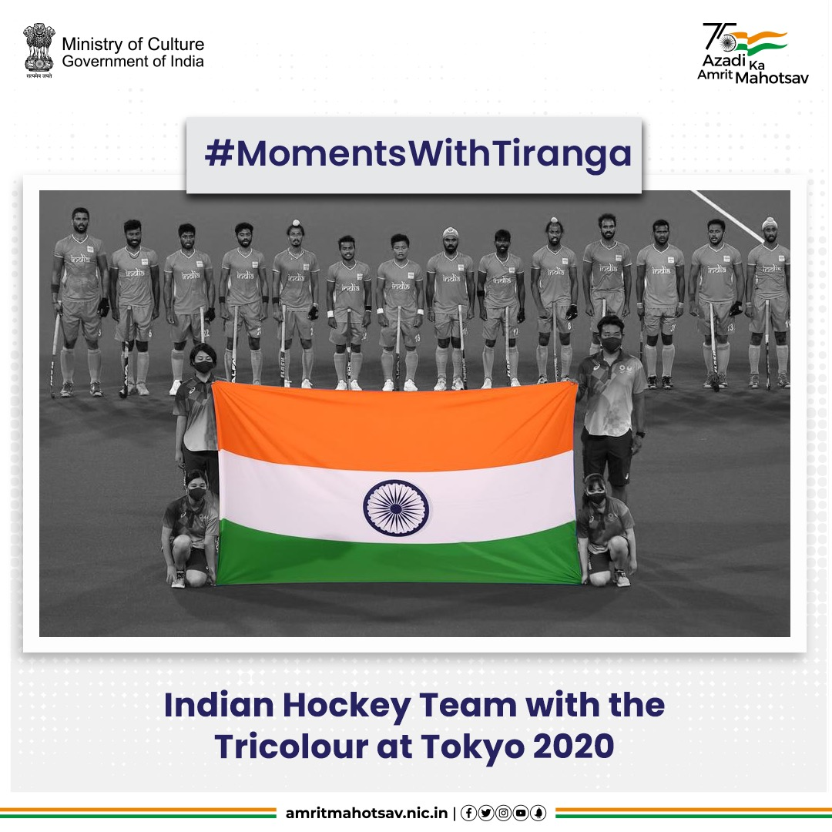
A date with history! At #Tokyo2020, the Indian Hockey team not only won a bronze medal🥉 but also found its way back to the Olympic podium after over 4 decades 🙌🇮🇳 #AmritMahotsav #MomentsWithTiranga #HarGharTiranga #MainBharatHoon #IndiaAt75 #IdeasAt75 @Olympics IC: @WeAreTeamIndia

Slide 18
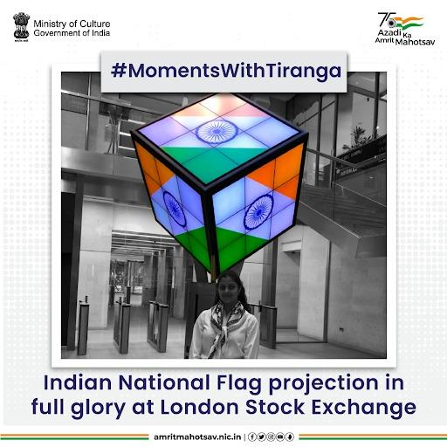
This pic just made our day! All the way from the #LondonStockExchange 🇮🇳 #AmritMahotsav #MomentsWithTiranga #HarGharTiranga #MainBharatHoon #IndiaAt75 IC: @ashabhosle

Slide 19
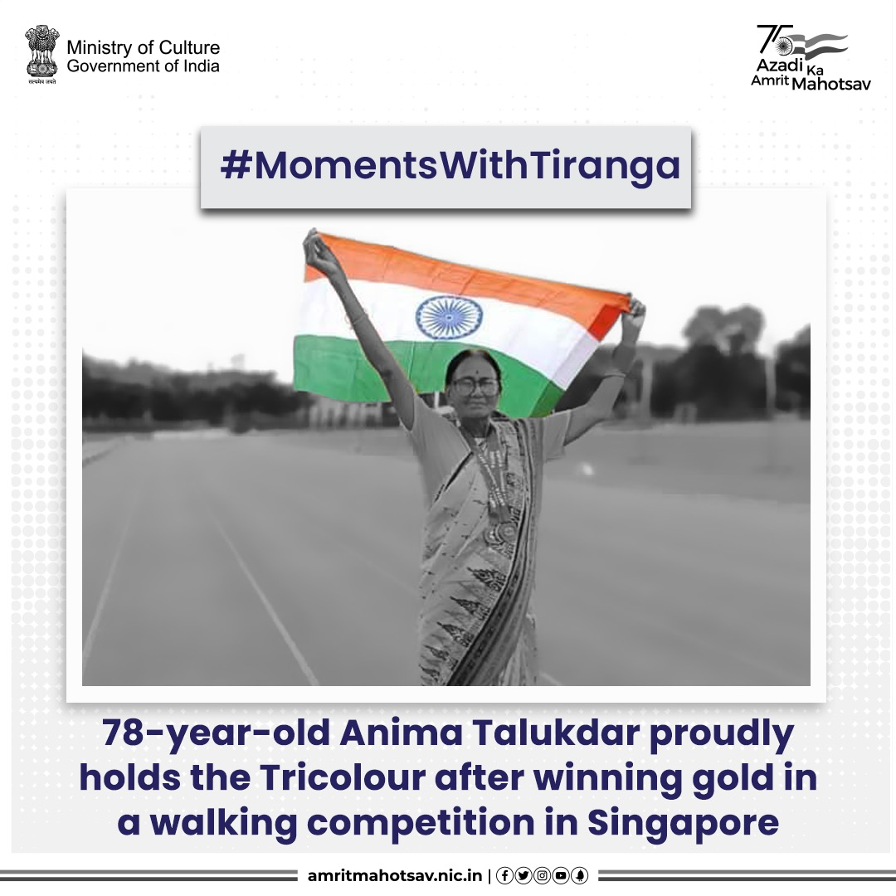
Age no bar! At 78, Anima Talukdar, a retired school headmistress from Kalna, West Bengal won a gold🥇for India in 3000 mtr walk competition at International Masters’ Track & Field Championship 2022 in Singapore. She celebrated her victory with the #Tiranga🙌🇮🇳 #AmritMahotsav #MomentsWithTiranga #HarGharTiranga #MainBharatHoon #IndiaAt75

Slide 20
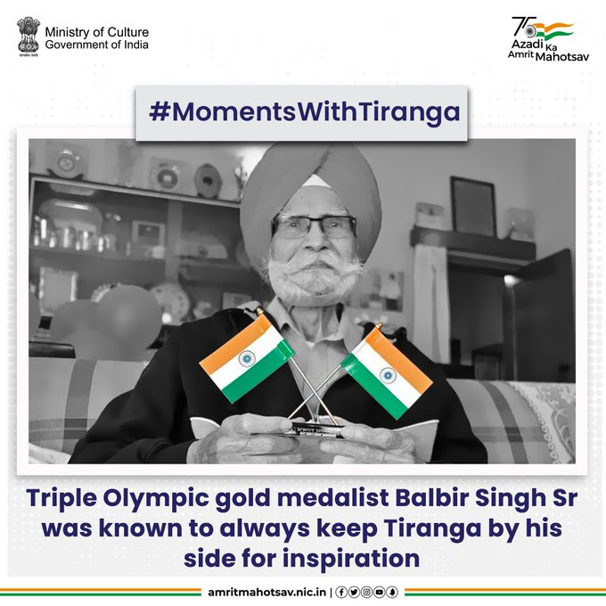
Hockey legend. #BalbirSingh Sr's world record for most goals scored by an individual in the men’s hockey final of the #Olympics still remains unbeaten. It is said, he always used to keep #Tiranga by his side for inspiration & motivation
#AmritMahotsav #MomentsWithTiranga

Slide 21
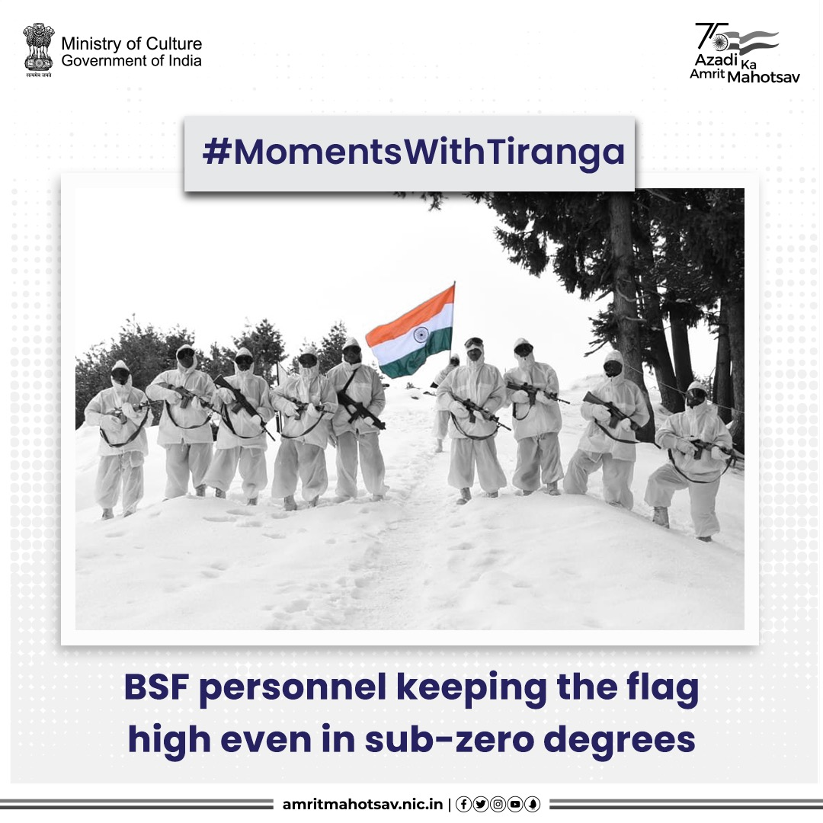
Till the time we have our brave soldiers guarding us, we know we & the Tiranga will stay strong 🇮🇳 #AmritMahotsav #MomentsWithTiranga #HarGharTiranga #MainBharatHoon #IndiaAt75 #ActionsAt75 IC: @BSF_India

Slide 22
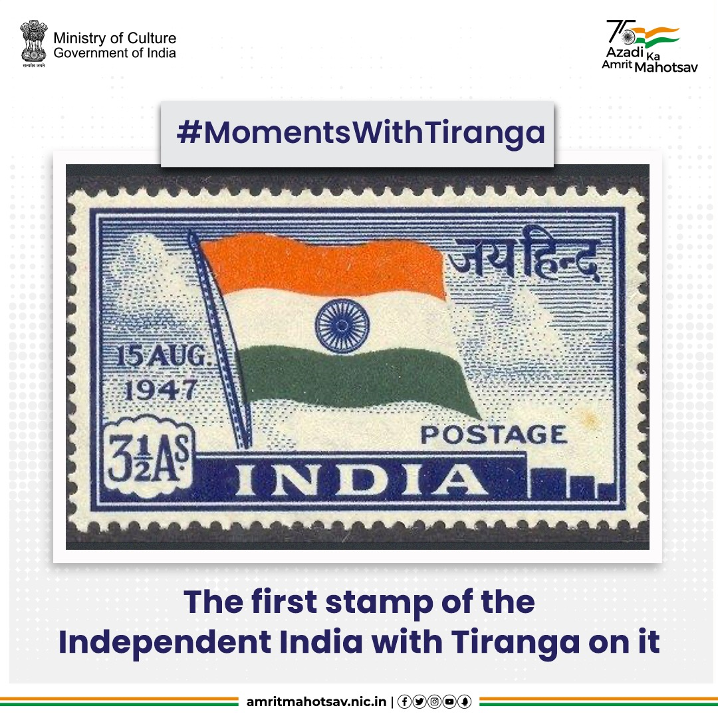
#DidYouKnow? The 1st Stamp of Independent India was issued on 21 Nov 1947 and depicted
the Indian Flag with the patriots' slogan, 'Jai Hind'. It was valued at three & one-half annas 🇮🇳 #AmritMahotsav #MomentsWithTiranga #HarGharTiranga #TirangaAnecdotes #MainBharatHoon #IndiaAt75 #ResolveAt75

Slide 23
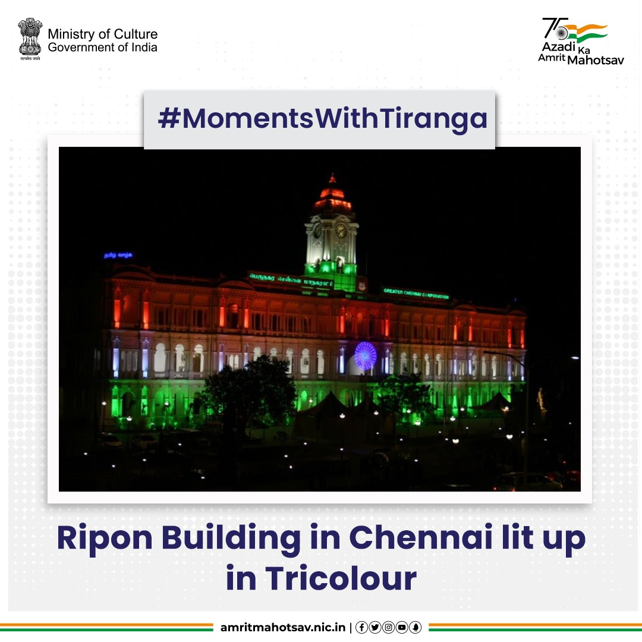
Anything that dawns saffron, white & green, lights up with beauty! Ripon Building in Chennai on independence day...stunning🇮🇳 #AmritMahotsav #MomentsWithTiranga #HarGharTiranga #MainBharatHoon #IndiaAt75 #ResolveAt75 IC:
@bijoyghosh70

Slide 24
Know Your Tiranga

Slide 25
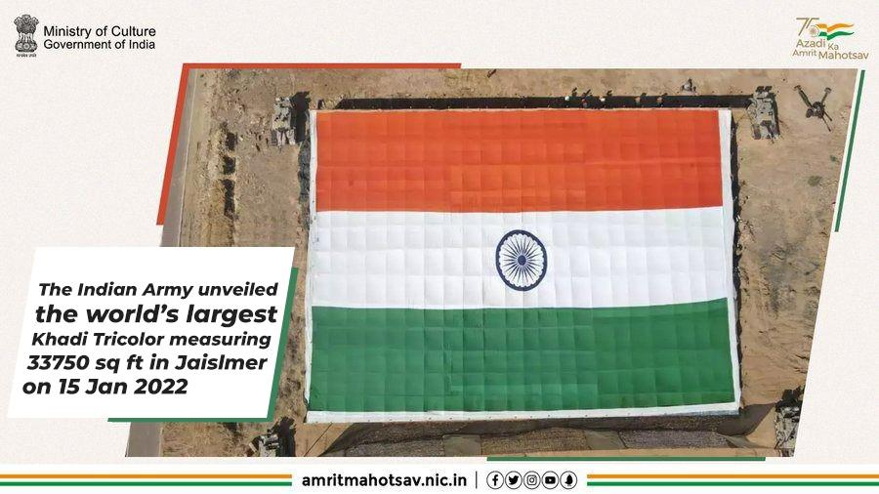
The Indian flag was displayed at the iconic site of the Battle of Longewala in 1971, on the occasion of 74th Army Day. The flag was 225 feet long & 150 feet wide & weighs 1400 kgs. The flag is a creation by Khadi & Village Industries Commission (KVIC) to celebrate ongoing #AmritMahotsav

Slide 26
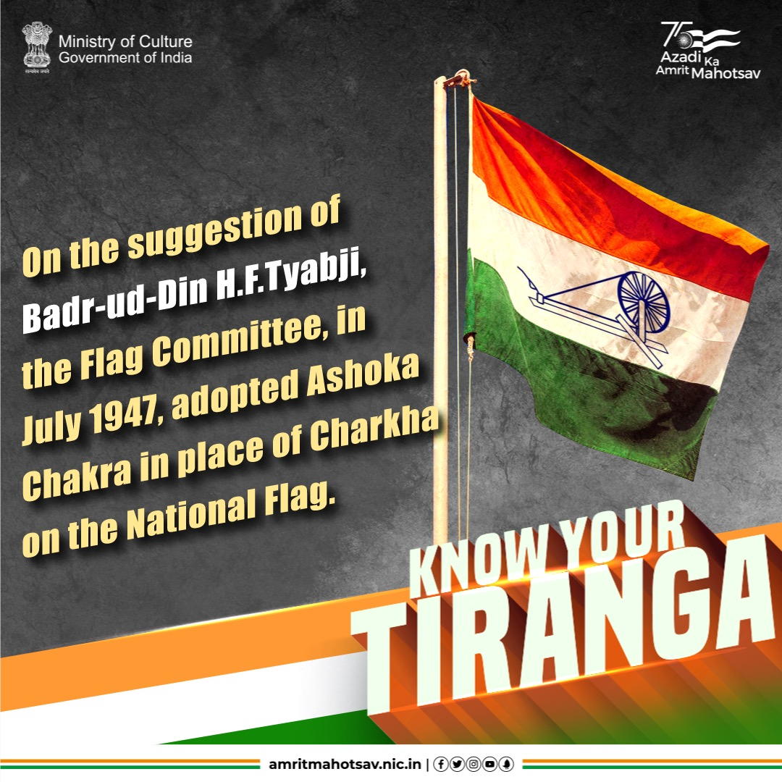
The idea to use Ashoka Chakra instead of Chakra was suggested by Badr-ud-Din H.F. Tyabji. He was further advised by the committee to consult #Gandhiji to whom he showed a sample made by his wife. Gandhiji happily gave the nod to the new design & the committee immediately adopted it on the Flag 🇮🇳#AmritMahotsav #HarGharTiranga #MainBharatHoon #IndiaAt75 #ActionsAt75

Slide 27
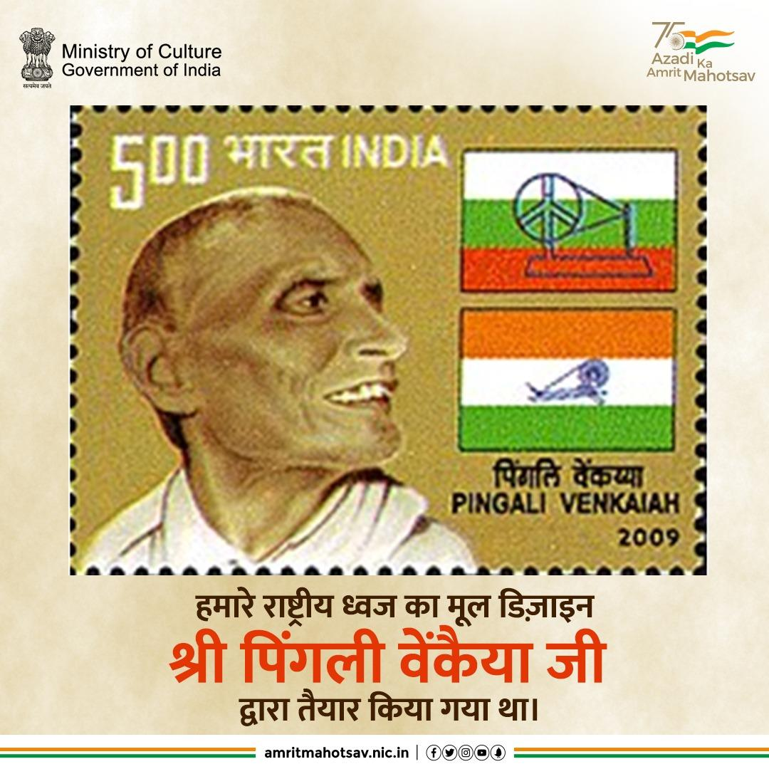
देश के राष्ट्रीय ध्वज तिरंगे का मूल डिज़ाइन आंध्र प्रदेश के स्वतंत्रता सेनानी श्री पिंगली वैंकया जी द्वारा डिजाइन किया गया था। वह महात्मा गांधी जी के विचारों से प्रभावित थे, और उनके कहने पर उन्होंने राष्ट्रीय ध्वज को डिजाइन किया।

Slide 28
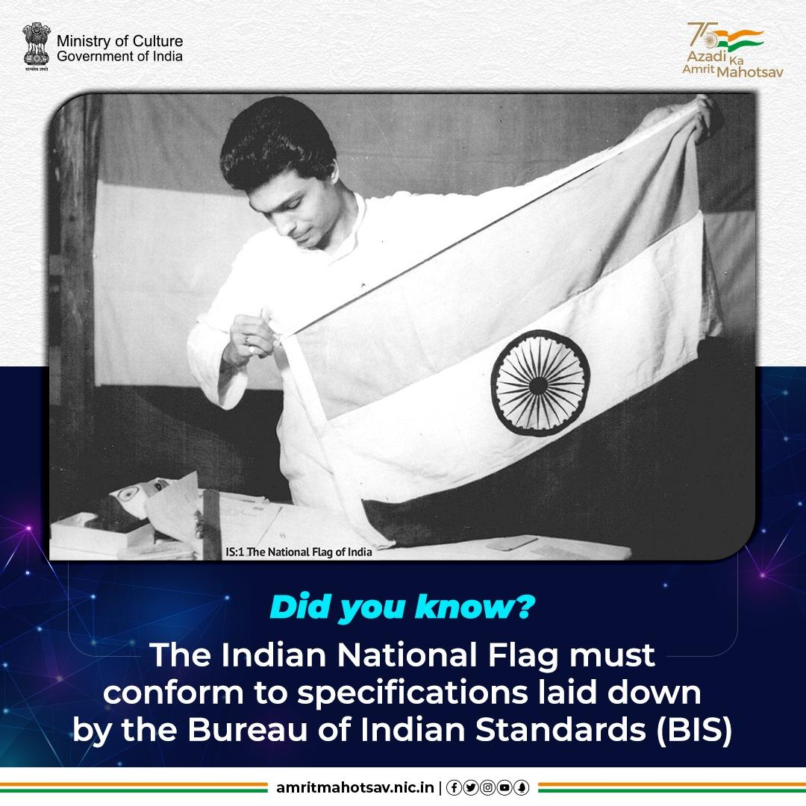
Our flag marks the beginning of India's foray into Standardisation. The first standard set by @IndianStandards - IS:1 defines the Specifications for the National Flag of India(Cotton Khadi) #AmritMahotsav #MainBharatHoon

Slide 29
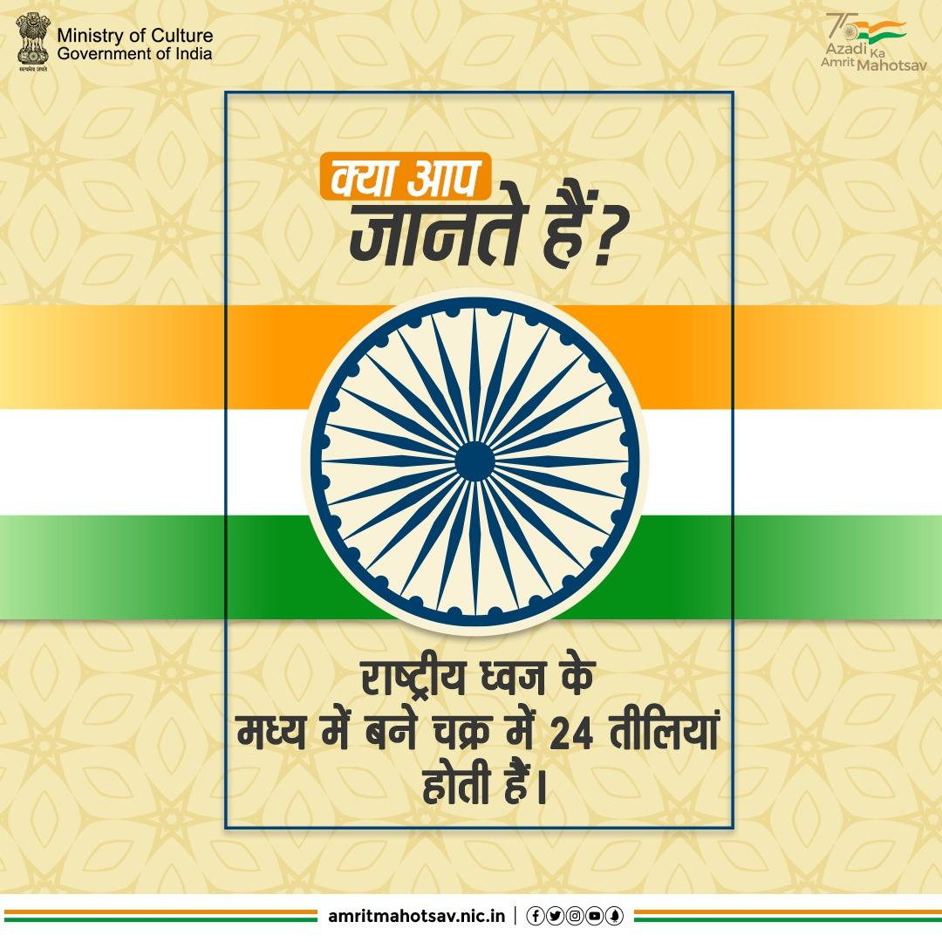
हमारे राष्ट्रीय ध्वज तिरंगे में बने चक्र में 24 तीलियां होती हैं, जो अशोक चक्र की प्रतीक हैं। यह चक्र सम्राट अशोक के अनेक शिलालेखों में पाया गया है।

Slide 30
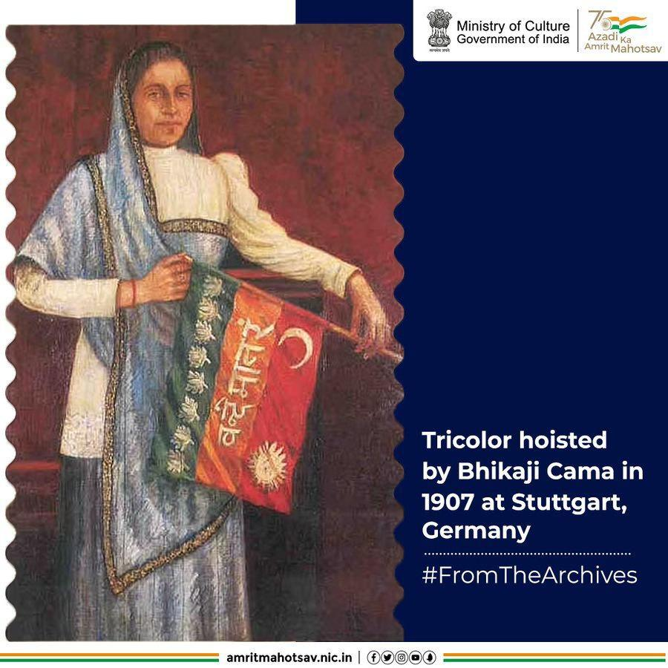
#BhikajiCama herself co-designed the flag. The 8 lotuses in the flag represented the 8 provinces & the 3 stripes represented unity among all religions of India. The tricolor also featured the words Vande Mataram written right in the middle #AmritMahotsav #FromTheArchives

Slide 31
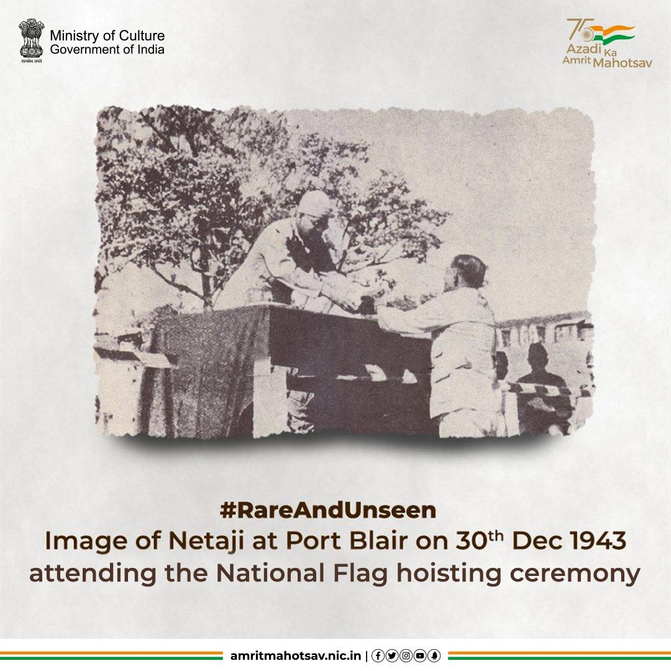
#Netaji became the first person to hoist the Indian National Flag on the liberated (from British) soil of Andaman & Nicobar Islands. This #RareAndUnseen image is from the flag hoisting ceremony held at the Gymkhana Ground in Port Blair on 30 Dec 1943 #AmritMahotsav

Slide 32
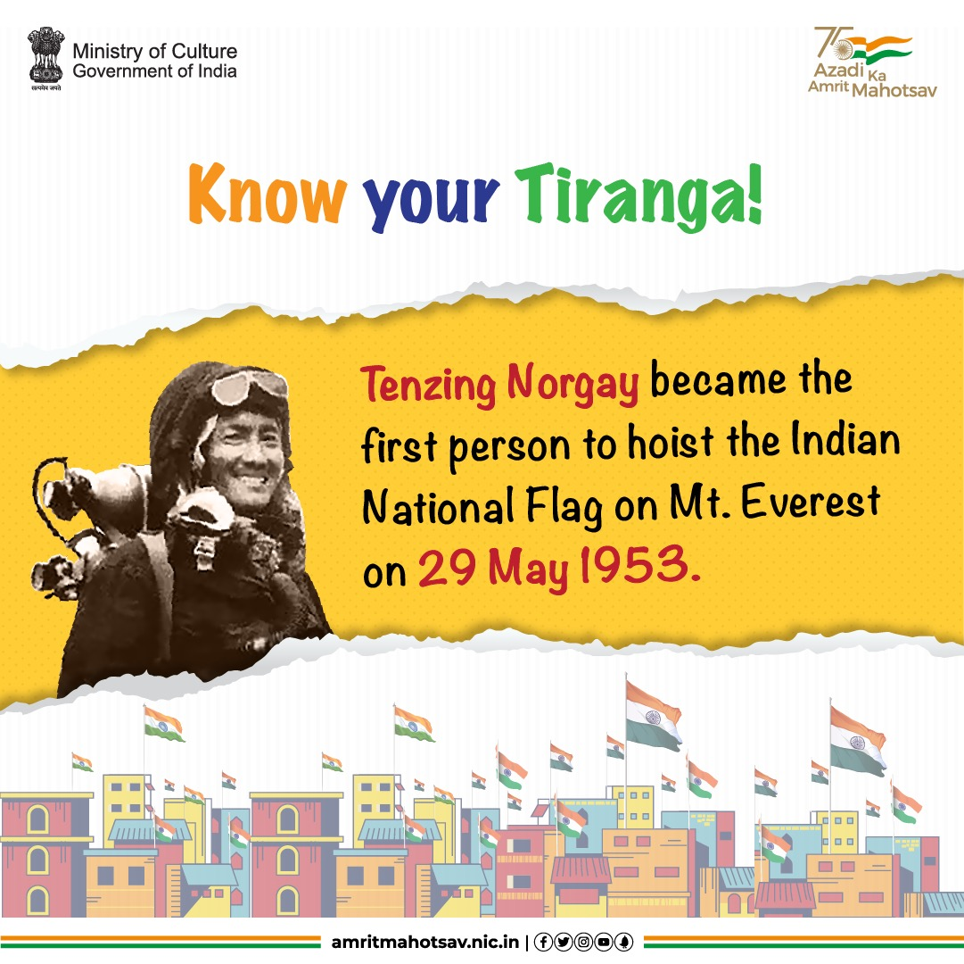
On reaching the top of the summit, Tenzing Norgay, one of the first 2 men to conquer Mt. Everest, unfurled India's National Flag. Thus becoming the first person to do so in 1953 🇮🇳#AmritMahotsav #KnowYourTiranga #HarGharTiranga #MainBharatHoon #IndiaAt75 #ActionsAt75 #Trivia #IndianNationalFlag
Source: https://timesofindia.indiatimes.com/city/kolkata/the-unknown-face-behind-first-climb/articleshow/47909351.cms#:~:text=%22Tenzing%20was%20merely%20a%20'sardar,%2C%22%20he%20re%2Dcalled.

Slide 33
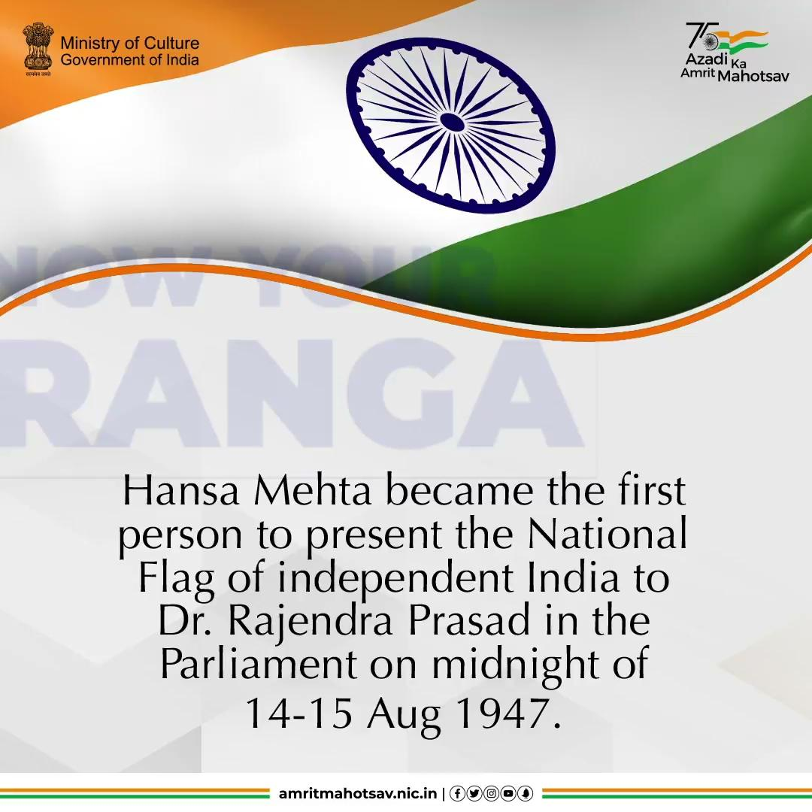
Leading a group of 72 women, Hansa Mehta presented the first National Flag of independent #India to Dr. Rajendra Prasad, the Chairman of the Constituent Assembly, in the Parliament on the midnight of 14-15 Aug 1947 🇮🇳#AmritMahotsav #KnowYourTiranga #HarGharTiranga #MainBharatHoon #IndiaAt75 #ActionsAt75 #Trivia
Source: https://flagfoundationofindia.in/know-your-national-flag.html
Download link:
https://drive.google.com/file/d/1cVJDizwB5ZkUoaGPmcP0a-3-QEpLKK6t/view?usp=sharing

Slide 34
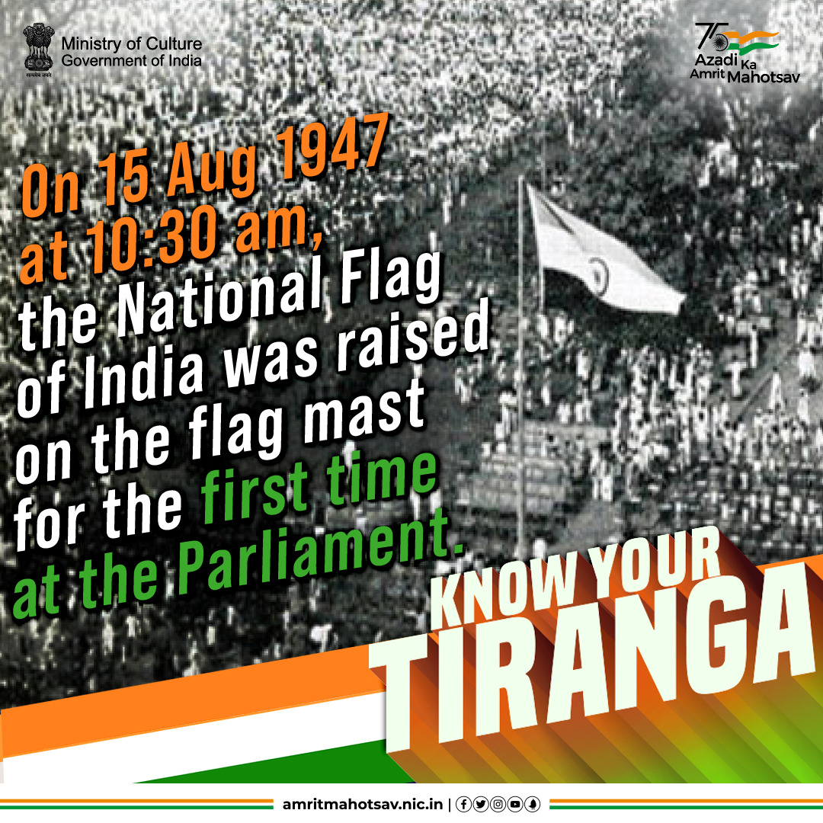
On 15th Aug 1947 at 10:30 am #India witnessed history in the making. It was the day the British flag was lowered by Louis Mountbatten, giving way to the Indian National Flag, which was raised for the first time on the flag mast at the Parliament. Goosebumps! 🇮🇳#AmritMahotsav #KnowYourTiranga #HarGharTiranga #MainBharatHoon #IndiaAt75 #ActionsAt75 #Trivia

Slide 35
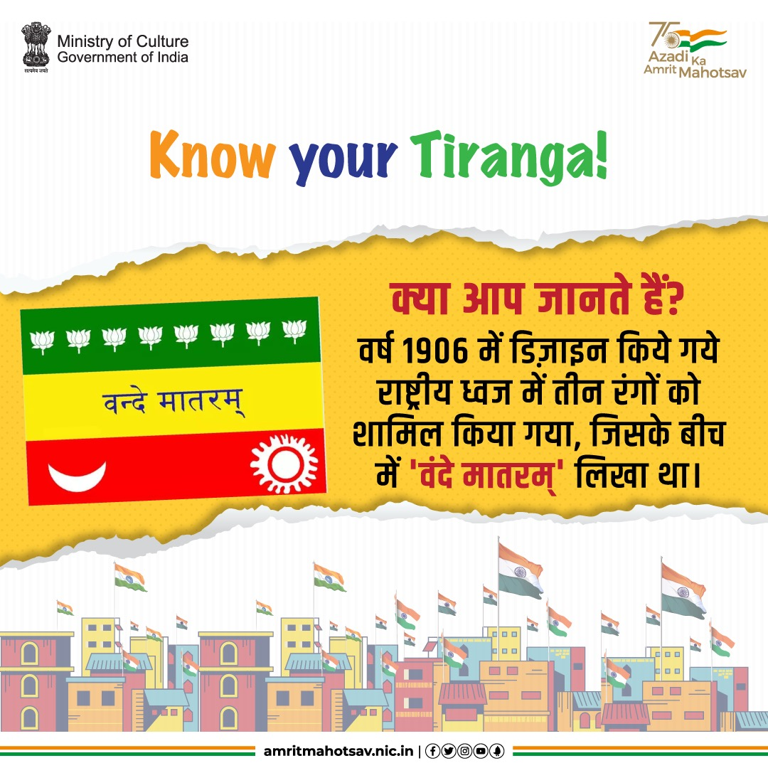
वर्ष 1906 में डिजाइन किये गये राष्ट्रीय ध्वज में तीन रंगों का समावेश किया गया था, जिसके बीच में वंदे मातरम् लिखा था। इस ध्वज में तारों के साथ ही चांद और सूरज की आकृतियां भी दर्शायी गयी थी। बाद में इसमें थोड़ा परिवर्तन कर तारों को कमल के फूल से बदल दिया गया।

Slide 36
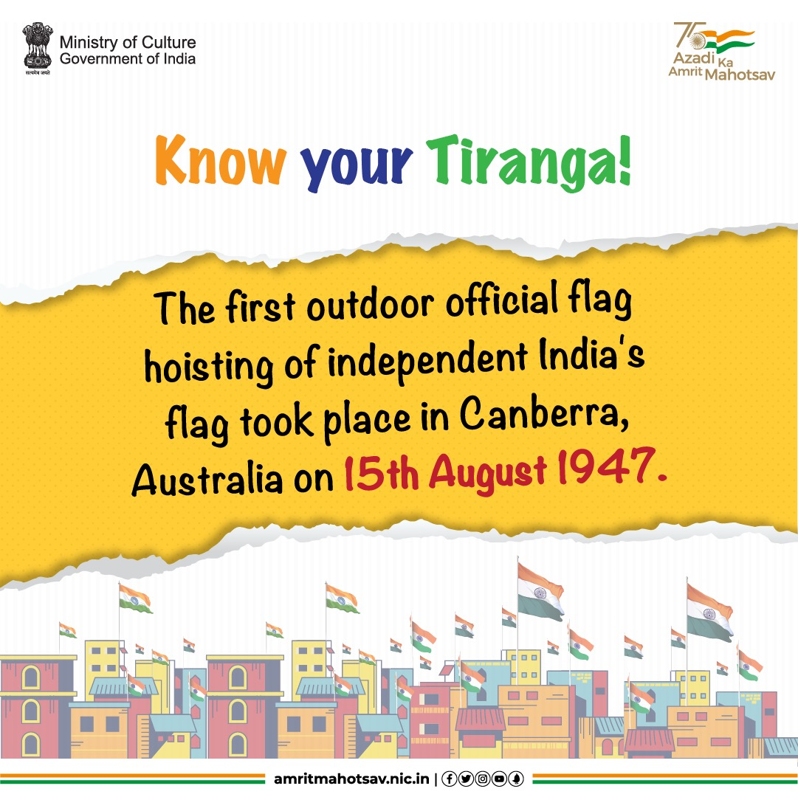
Here's some interesting trivia on the National Flag for you: The first outdoor official flag hoisting of our National Flag took place on 15th Aug 1947, in Canberra, Australia at the residence of Sir Raghunath Paranype, the High Commission of India in Australia. Interestingly, because of the difference between the two countries, the hoisting was done around 4.3 hrs in advance there 🇮🇳 #AmritMahotsav #KnowYourTiranga #HarGharTiranga #MainBharatHoon #IndiaAt75 #ActionsAt75 #Trivia #IndianNationalFlag
Source: https://flagfoundationofindia.in/know-your-national-flag.html

Slide 37
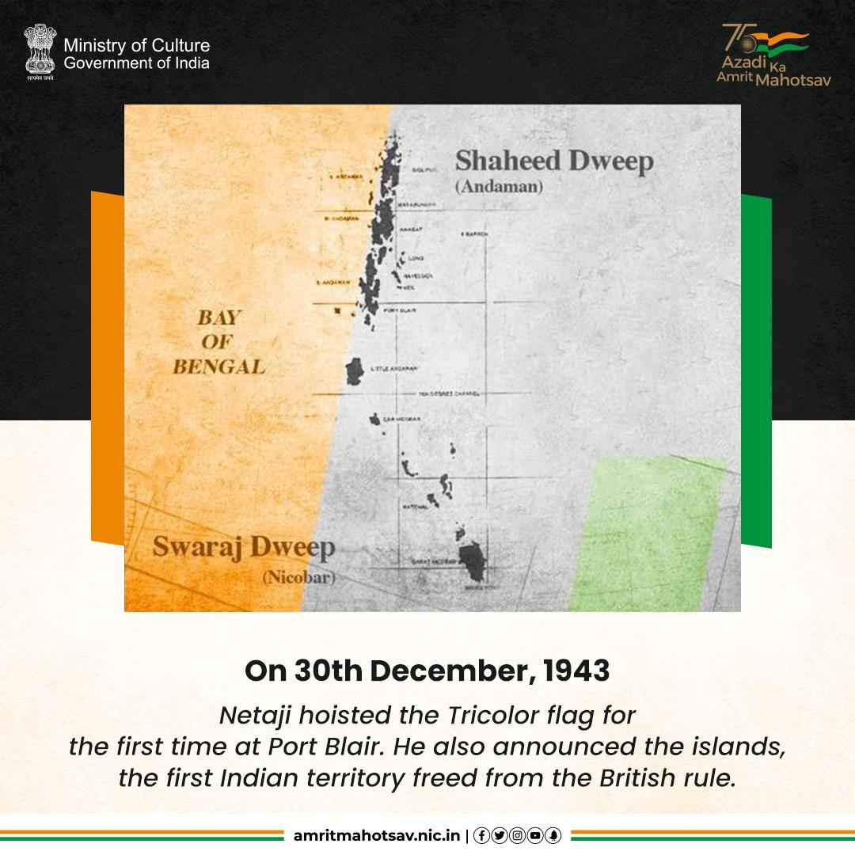
On 30th December 1943, Netaji hoisted the Tricolor flag for the first time in Port Blair and renamed the Andaman Islands as Shaheed Dweep & Nicobar Islands as Swaraj Dweep. #AmritMahotsav #MainBharatHoon #Netaji #NetajiSubhasChandraBose

Slide 38

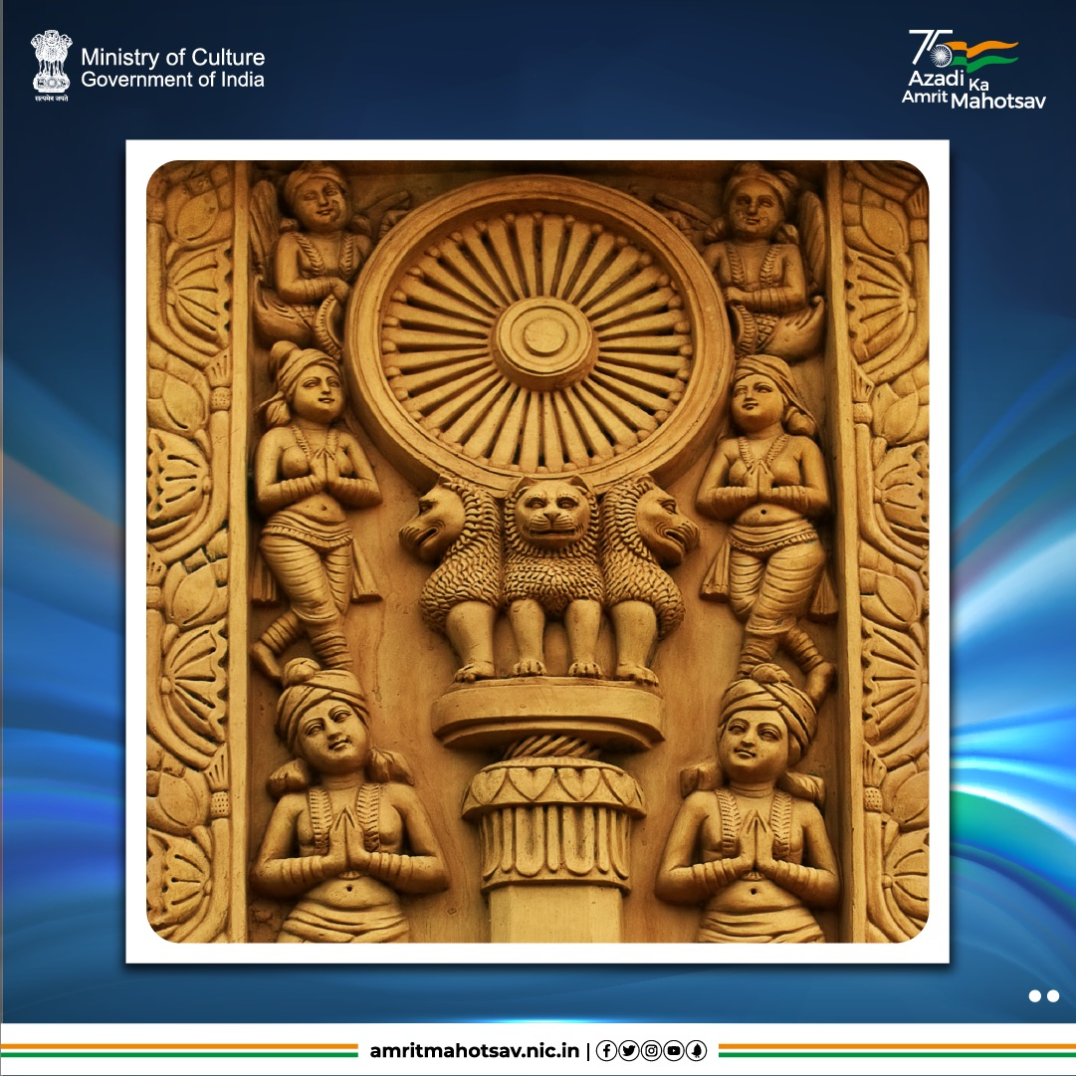
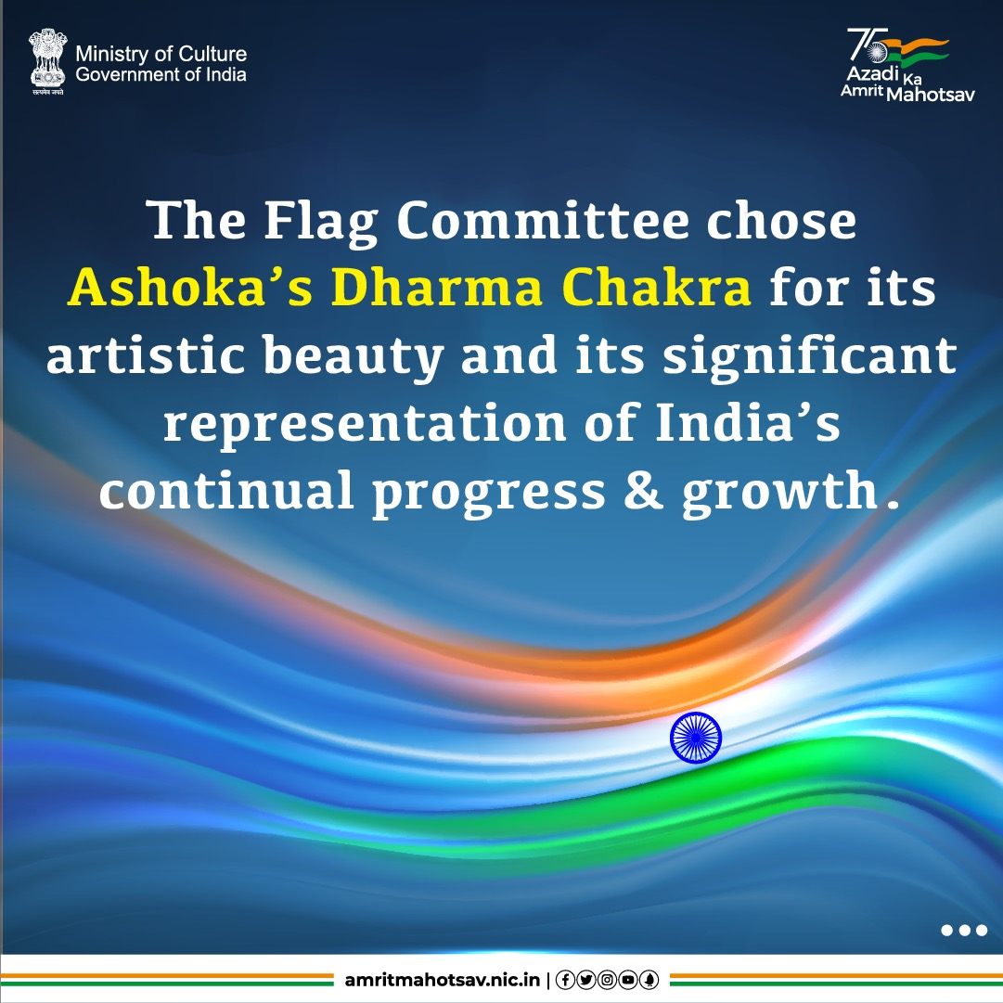
Carousel:
#DidYouKnow that in July 1947, the Flag Committee chose Ashoka’s Dharma Chakra as a symbol on the flag for the reason that amongst all the chakras that came to their mind the “Sarnath Chakra” was the most striking & artistic #AmritMahotsav #HarGharTiranga #MainBharatHoon #IndiaAt75 #ActionsAt75

Slide 39
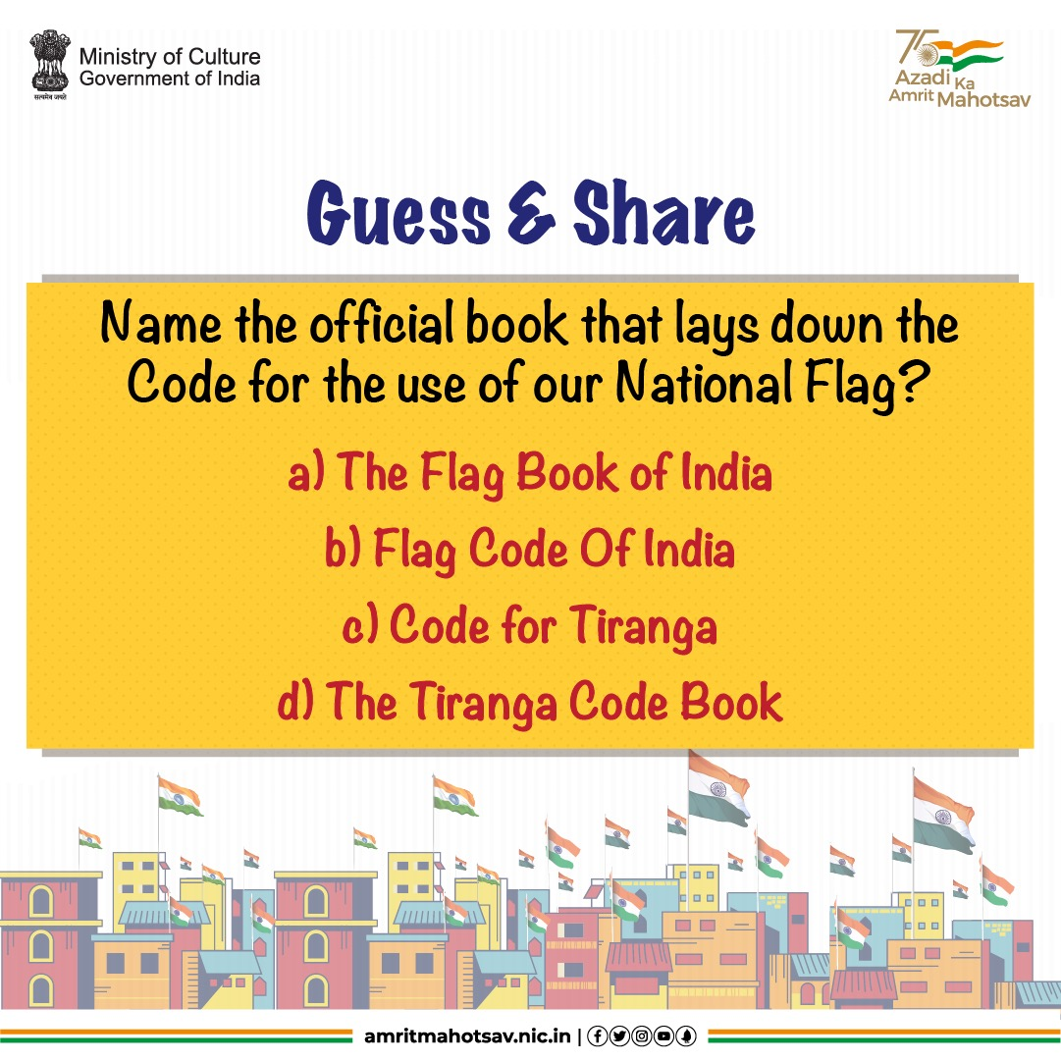
Let's see how well you know the #IndianNationalFlag. #Guess and share the answer to this question in the comments below & don't forget to tag friends 🇮🇳#AmritMahotsav #GuessAndShare #HarGharTiranga #MainBharatHoon #IndiaAt75 #ActionsAt75 #Trivia

Slide 40
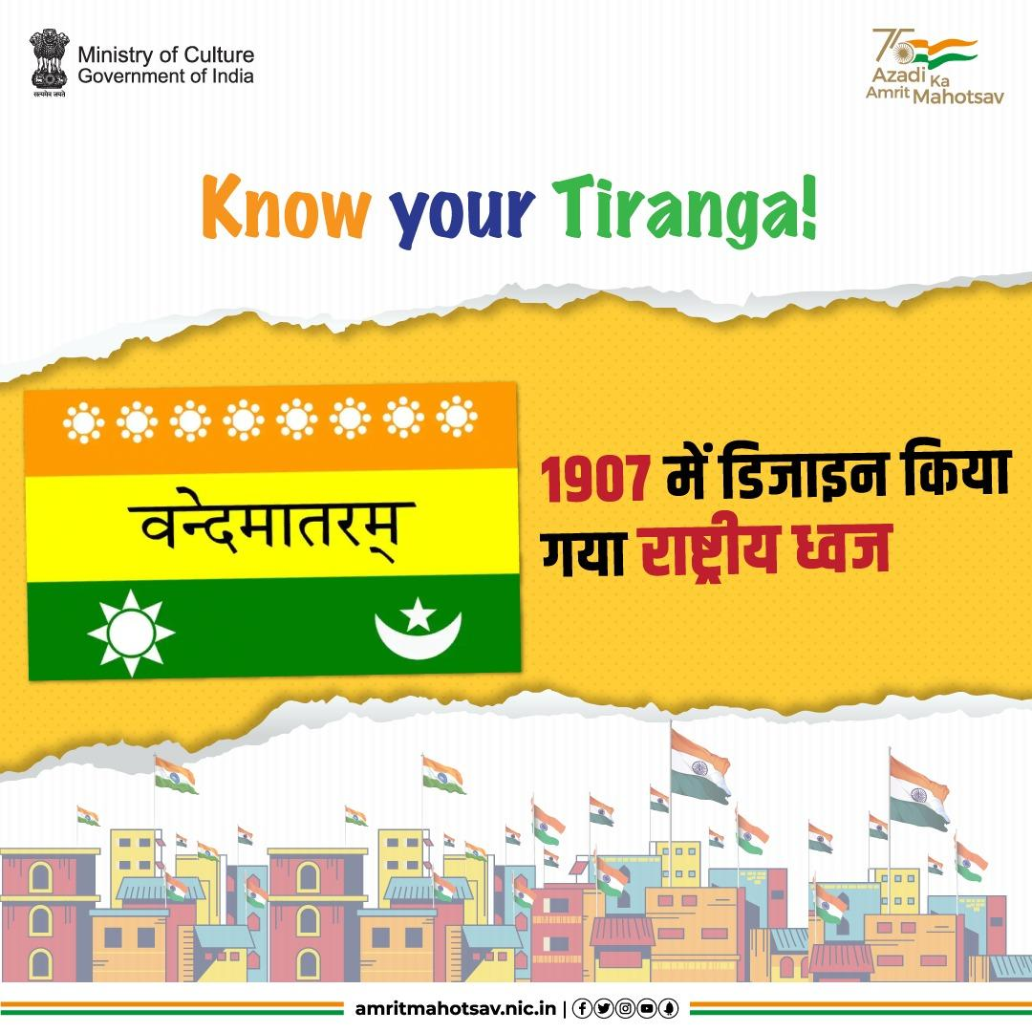
श्याम जी कृष्ण वर्मा, मैडम भीकाजी कामा, तथा वीर सावरकर जी ने वर्ष 1907 में राष्ट्रीय ध्वज का नया संस्करण तैयार किया। जिसमें डिजाइन के साथ रंगों में भी बदलाव किया गया था।

Slide 41
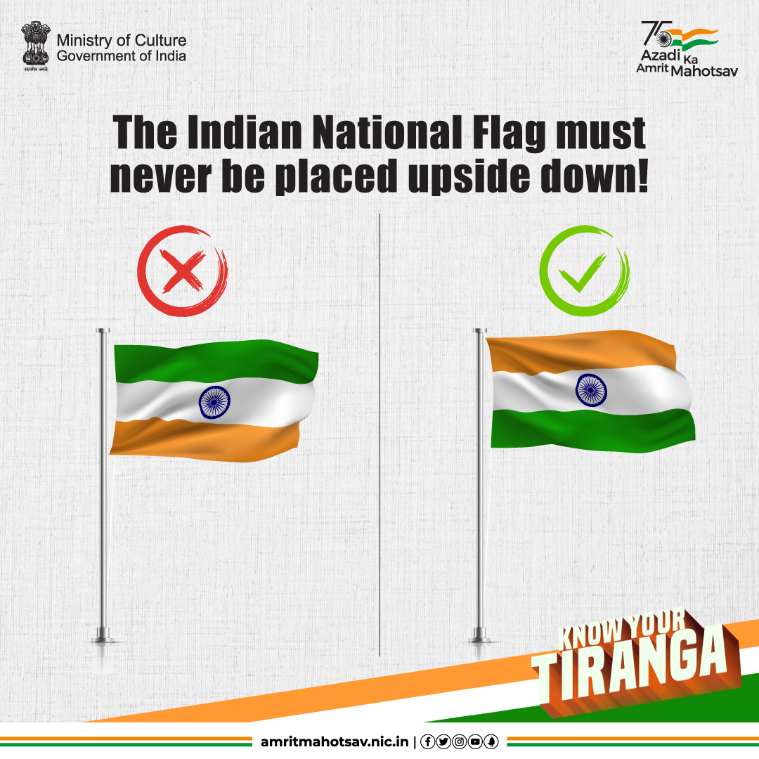
#KnowYourTiranga protocol: The National Flag must never be placed upside down. Our Flag is our pride & should always fly high! 🇮🇳 #AmritMahotsav #HarGharTiranga #MainBharatHoon #IndiaAt75

Slide 42
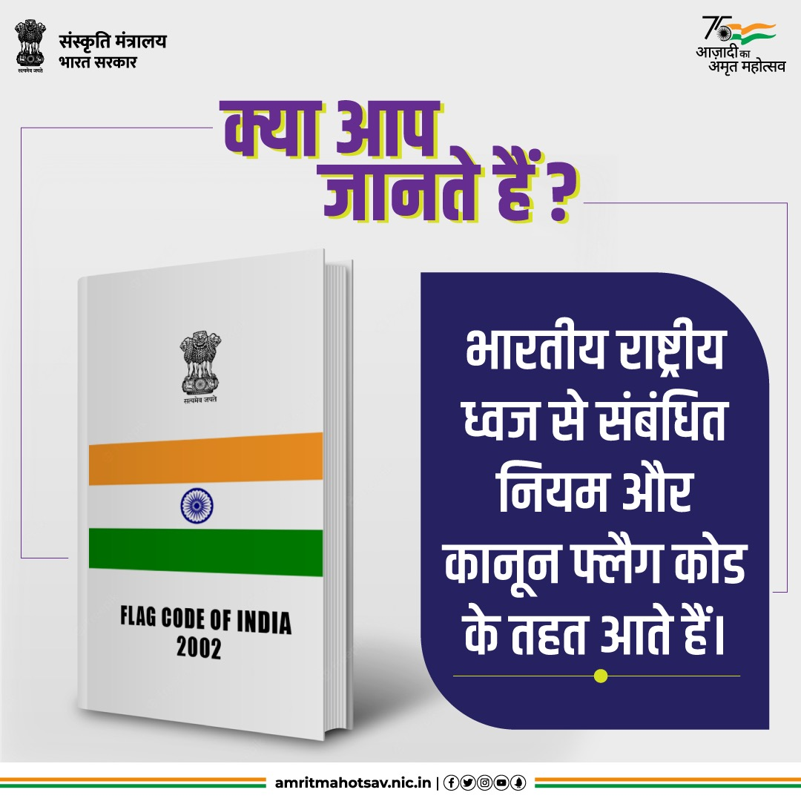
निजी, सार्वजनिक तथा सरकारी संस्थानों द्वारा राष्ट्रीय ध्वज के प्रदर्शन से संबंधित सभी कानून, परंपरा और निर्देश फ्लैग कोड के तहत आते हैं। यह फ्लैग कोड 26 जनवरी 2002 को लागू हुआ था।

Slide 43
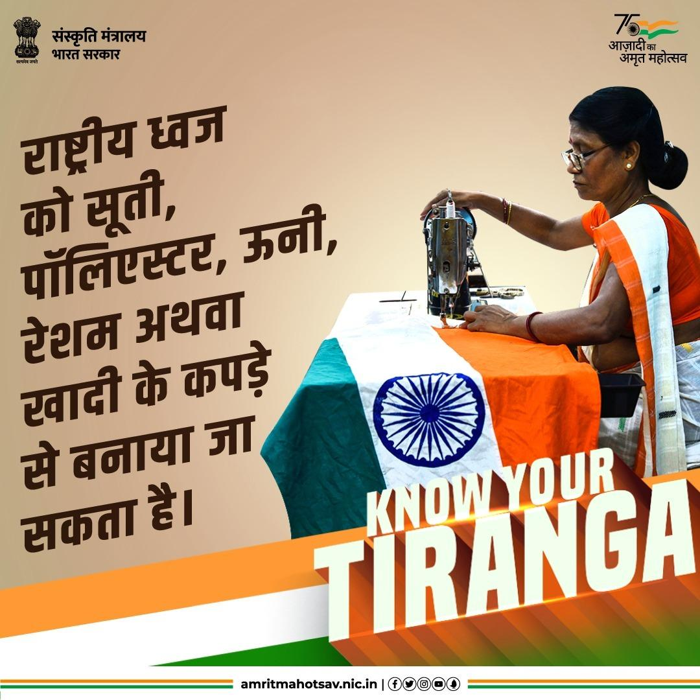
फ्लैग कोड 2002 को 30 दिसंबर 2021 में संशोधित कर राष्ट्रीय ध्वज को पॉलिएस्टर या मशीन से ध्वज बनाने की अनुमति दी गयी। अब राष्ट्रीय ध्वज को हाथ से या मशीन से सूती, पॉलिएस्टर, ऊन, रेशम या खादी के कपड़े द्वारा बनाया जा सकता है।

Slide 44
Har Ghar Tiranga Collaterals

Slide 45
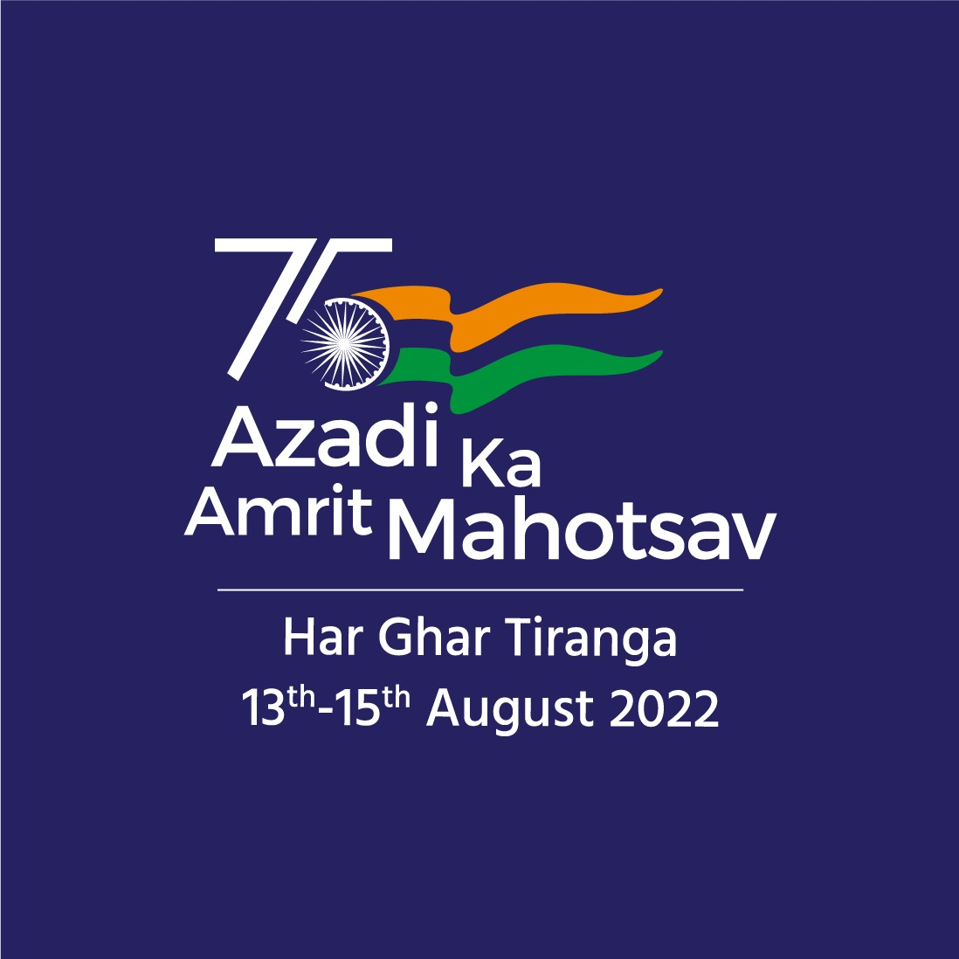

Slide 46
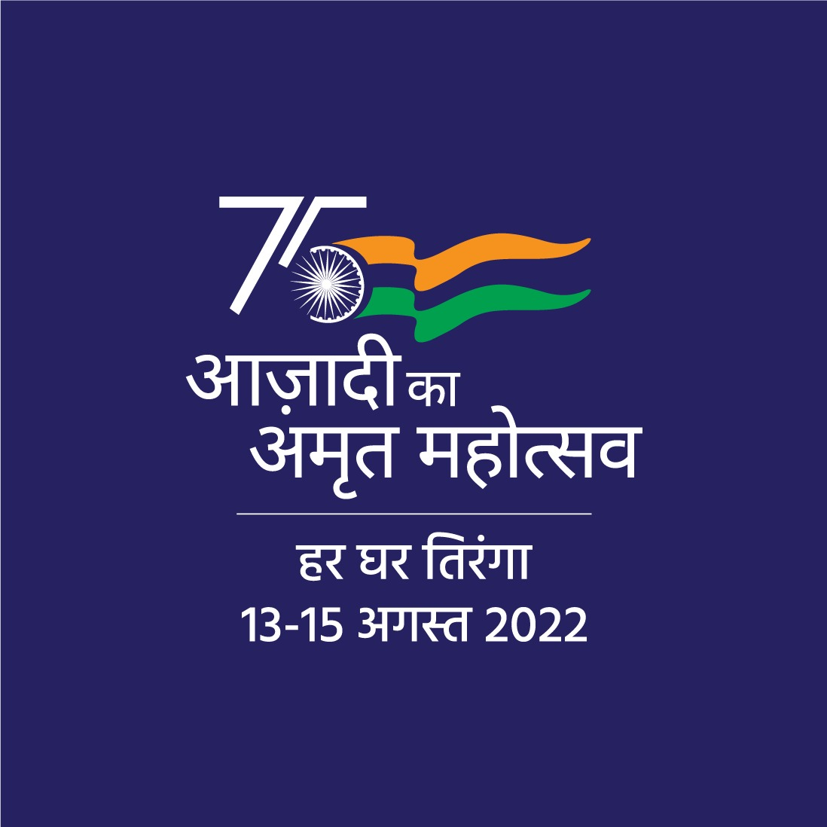

Slide 47
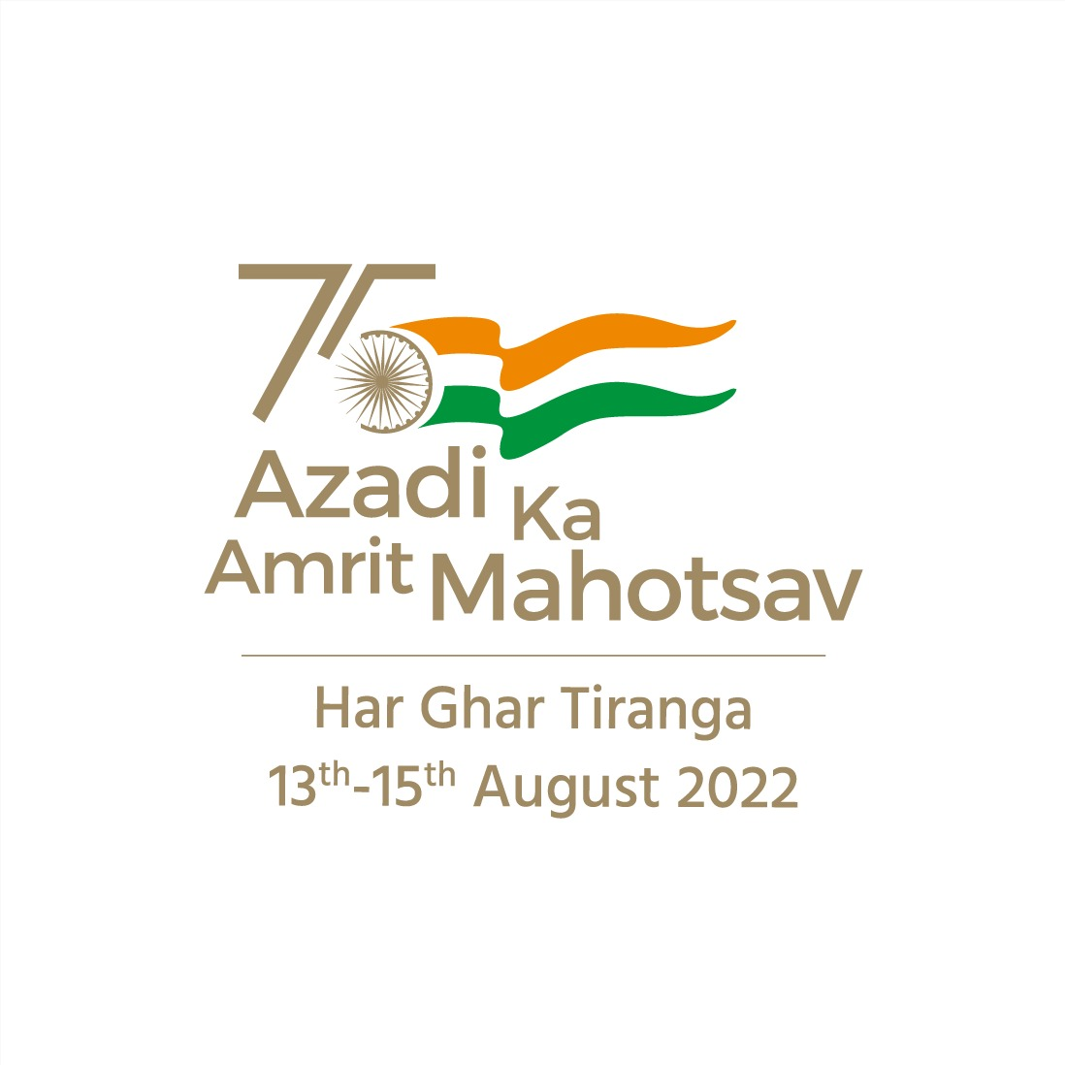

Slide 48
